Slide 1
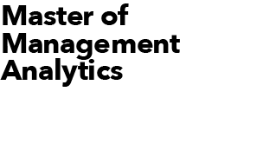
Women’s ice-hockey team prediction (NWHL 2021-22)
MMA Summer 2023 Online Datathon
June 16, 2023 Team White

Slide 2
Team White Members
Tushar Raju
Natacha Mao
Rishik Raj
Shuyan Huang

Slide 3

Business objective
Assist the NWHL Toronto Six Managers assemble a team for the upcoming 2021-22 NWHL season.
Analytical Objective
Evaluate the performance of the players and identify 5 top players.

Slide 4
Data Sources
Data Overview
Women’s hockey data from the NWHL 2020-21 Season – Stathletes
Player’s position, age, nationality & college – Premier Hockey Federation (PHF) & Elite Prospects (EP)
Data Description
The women’s hockey data from the NWHL 2020-21 season consists of a list of events - shots, plays, takeaways, puck recoveries, dump ins, dump outs, zone entries, faceoffs and penalties. Data regarding the date, home team, away team, player, X & Y co-ordinates of the event, score, clock time and more details are included.
The player’s position, age, nationality & college were manually retrieved from the PHF & EP websites.

Slide 5
METHODOLOGY
Tools Used:
Microsoft Excel
Python
Identify important factors
Offence & Defence
Breakdown the factors and assign each factor a multiplier value to define a formula.
Evaluate the ratings of each player based on the formula defined.
Identify the best overall, offensive & defensive ranked players.
Identify 2 more players with good chemistry and good overall ranking.

Slide 6
ANALYSIS
Identifying Important Aspects
To create an equation to evaluate each player’s performance as per the women’s hockey NWHL 2020-21 season data, we researched online and identified the most important aspects to be considered for an offensive & defensive player individually.
Offensive Factors | Defensive Factors
1. Scoring | 1. Passing
2. Passing | 2. One on One Situations
3. On-Puck & Off-Puck Movement | 3. Steals & Defending

Slide 7
EVALUATION BREAKDOWN
We have classified each of the factors based on the data. Each factor has been assigned a percentage of the total rating based on the importance of the trait in the game to help determine the overall rating.
Offensive Rating Breakdown
Scoring (40%)
Shots | 25%
Goals | 15%
Passing (35%)
Offensive Passing | 35%
On-Puck & Off-Puck Movement (25%)
Puck Recovery (Offensive Zone) | 15%
Zone Entry | 5%
Dump In/Out (Offensive Zone) | 5%
Total | 100%
Defensive Rating Breakdown
Passing (34%)
Defensive Passing | 34%
One on One Situations (33%)
Faceoff Win (Defensive Zone) | 12%
Faceoff Win (Offensive Zone) | 8%
Dump In/Out (Defensive Zone) | 13%
Steals & Defending (33%)
Takeaways | 20%
Puck Recovery (Defensive & Centre Zone) | 13%
Total | 100%
Overall Rating = Offensive Rating + Defensive Rating

Slide 8
RANKING RESULTS
OFFENCE STATS
Ranking | Player | Rating
#1 | Alyssa Wohlfeiler | 59.31
#2 | Theresa Knutson | 59.01
#3 | McKenna Brand | 57.48
DEFENCE STATS
Ranking | Player | Rating
#1 | Tereza Vanisova | 80.97
#2 | Amy Curlew | 76.13
#3 | Carlee Turner | 76.08

Slide 9

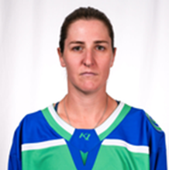

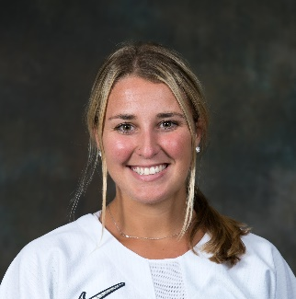

IDEAL TEAM AS PER ANALYSIS
Choice 1
McKenna Brand
Offence Ranking | #3
Defence Ranking | #4
Overall Ranking | #1
Age | 27
Alyssa Wohlfeiler
Offence Ranking | #1
Defence Ranking | #65
Overall Ranking | #24
Age | 34
Tereza Vanisova
Offence Ranking | #59
Defence Ranking | #1
Overall Ranking | #5
Age | 27
Samantha Davis
Offence Ranking | #13
Defence Ranking | #12
Overall Ranking | #7
Age | 26
Taylor Wenczkowski
Offence Ranking | #14
Defence Ranking | #19
Overall Ranking | #10
Age | 25
Chemistry Heat Map
Team Total Overall Ranking | 47
Result:
This team has the highest ranked players in each trait and has the experience of Alyssa to guide the team.
Players | Alyssa Wohlfeiler | McKenna Brand | Samantha Davis | Taylor Wenczkowski | Tereza Vanisova
Alyssa Wohlfeiler
McKenna Brand
Samantha Davis
Taylor Wenczkowski
Tereza Vanisova

Slide 10
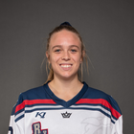
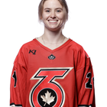


IDEAL TEAM AS PER ANALYSIS
Choice 2
McKenna Brand
Offence Ranking | #3
Defence Ranking | #4
Overall Ranking | #1
Age | 27
Theresa Knutson
Offence Ranking | #2
Defence Ranking | #10
Overall Ranking | #3
Age | 27
Amy Curlew
Offence Ranking | #5
Defence Ranking | #2
Overall Ranking | #2
Age | 25
Jillian Dempsey
Offence Ranking | #12
Defence Ranking | #29
Overall Ranking | #15
Age | 32
Christina Putigna
Offence Ranking | #20
Defence Ranking | #25
Overall Ranking | #16
Age | 27
Chemistry Heat Map
Team Total Overall Ranking | 37
Result:
This team has a better team total overall ranking and is a younger team which has a potential to grow well together.
Players | Amy Curlew | Christina Putigna | Jillian Dempsey | McKenna Brand | Theresa Knutson
Amy Curlew
Christina Putigna
Jillian Dempsey
McKenna Brand
Theresa Knutson

Slide 11
Thank You
Please refer below slides for more details on references, sources, formulas and code used.

Slide 12
References & Sources
Toronto Six Logo (Slide 2) - https://upload.wikimedia.org/wikipedia/en/9/93/Toronto_Six_Logo.png
PHF Website - https://www.premierhockeyfederation.com/stats#/100/leaders?division_id=20048
Elite Prospects - https://www.eliteprospects.com/stats
Offensive Factors Image (Slide 4) - https://a.espncdn.com/photo/2022/0210/r972558_1296x729_16-9.jpg
Defensive Factors Image (Slide 4) - https://s3.amazonaws.com/media.thecrimson.com/photos/2010/02/22/003242_1227890.jpg
Online Research – Offensive & Defensive Factors
https://www.minnesotahockey.org/news_article/show/588243-3-must-have-game-skills-for-forwards
https://hockeyperformanceacademy.com/7-factors-that-make-a-great-defender-in-field-hockey/
https://www.omha.net/news_article/show/990613
https://www.hockeycanada.ca/en-ca/hockey-programs/players/essentials/positions-skills/skating#:~:text=Skating%20is%20a%20skill%20required,perform%20to%20their%20full%20ability.
https://www.hockeycanada.ca/en-ca/hockey-programs/players/essentials/positions-skills/defence
Player Images (Slide 6 & 7) - https://www.premierhockeyfederation.com/stats#/100/leaders?division_id=20048
To evaluate the performance of the player, based on the event and details, points are allocated to the player. For example, a one-time shot goal in traffic gets +8 goal points and another +2 if the goal is scored when the scoring team is in a penalty kill situation. Another example, a fan (failure to execute) shot gets -2 shot points. These total points are then used to calculate the rating for each trait – Shots, Goals, Offensive Passing and so on. Please refer to appendix slides below for the formulas used to calculate rating, complete scoring breakdown and sample python code used to generate the points output.

Slide 13
Offensive Rating – Scoring Rating + Passing Rating + On-Puck & Off-Puck Movement Rating
1. Scoring Rating:
(Goal Points/(Goal Count*Maximum Goal Points))*15% + Shot Points/(Shot Count*Maximum Shot Points))*25%
2. Passing Rating:
(Offensive Play Points/(Offensive Play Count*Maximum Offensive Play Points))*35%
3. On-Puck & Off-Puck Movement Rating:
(Offensive Puck Recovery Points/(Offensive Puck Recovery Count*Maximum Offensive Puck Recovery Points))*15% + (Zone Entry/Total Zone Entry Points)*5% + (Offensive Dump In/Out Points/(Offensive Dump In/Out Count*Maximum Offensive Dump In/Out Points))*5%
Defensive Rating – Passing Rating + One on One Situation Rating + Steals & Defending Rating
Chemistry Rating:
Completed Plays Match + College Match + Team Match + Age Match
1. Passing Rating:
(Defensive Play Points/(Defensive Play Count*Maximum Defensive Play Points))*34%
2. One on One Situation Rating:
(Defensive Faceoff Win Points/(Defensive Faceoff Win Count*Maximum Faceoff Win Points))*12% + (Offensive Faceoff Win Points/(Offensive Faceoff Win Count*Maximum Faceoff Win Points))*8% + (Defensive Dump In/Out Points/(Defensive Dump In/Out Count*Maximum Defensive Dump In/Out Points))*13%
3. Steals & Defending Rating:
(Takeaway Points/(Takeaway Count*Maximum Takeaway Points))*20% + (Defensive Puck Recovery Points/(Defensive Puck Recovery Count*Maximum Offensive Puck Recovery Points))*13%

Slide 14
Event + Details | Points | Event + Details | Points
1, Goal + No Traffic + No One Time* | +5 | 16. Takeaway | +5
2. Goal + No Traffic + One Time* | +6 | 17. Puck Recovery + Offensive Zone | +5
3. Goal + Traffic + No One Time* | +7 | 18. Puck Recovery + Defensive Zone | +3
4. Goal + Traffic + One Time* | +8 | 19. Puck Recovery + Centre Zone | +4
5. Shot + Fan | -2 | 20. Incomplete Play + Defensive/Centre Zone* | -2
6. Shot + On Net | +2 | 21. Dump In/Out + Lost + Defensive/Centre Zone | +1
7. Shot + Missed | -1 | 22. Dump In/Out + Retained + Defensive/Centre Zone | +3
8. Shot + Blocked | +1 | 23. Play + Direct + Defensive/Centre Zone | +10
9. Play + Direct + Offensive Zone | +10 | 24. Play + Indirect + Defensive/Centre Zone | +5
10. Play + Indirect + Offensive Zone | +5 | 25. Faceoff Win + Defensive/Centre Zone | +4
11. Incomplete Play + Offensive Zone* | -2 | 26. Chemistry Per Play Completed | +1
12. Dump In/Out + Lost + Offensive Zone | +1 | 27. Chemistry for College Match | +20
13. Dump In/Out + Retained + Offensive Zone | +3 | 28. Chemistry for Team Match | +10
14. Zone Entry | +3 | 29. Chemistry for Age Match | +10
15. Faceoff Win + Offensive Zone* | +4
Each event contributes to a point total.
Please refer to the below table for the mapping.
Point Total | No.
Goal Points | 1,2,3,4
Shot Points | 5,6,7,8
Offensive Play Points | 9,10,11
Offensive Dump Points | 12,13
Zone Entry | 14
Offensive Faceoff Win Points | 15
Takeaway Points | 16
Offensive Puck Recovery Points | 17
Defensive Puck Recovery Points | 18,19
Defensive Plays Points | 20,23,24
Defensive Dump Points | 21,22
Defensive Faceoff Win Points | 25
*Based on Situation – Penalty Kill/Power Play, bonus points are added/deducted.

Slide 15
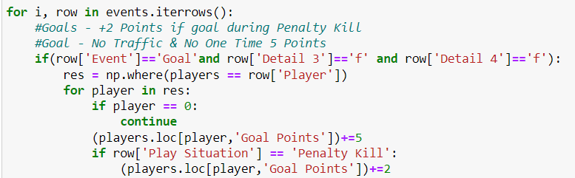
Sample Python Code
This code assigns 5 points to the player’s Goal Points tally if there is an event of the player scoring a goal in no traffic and not a one-time shot. 2 additional points are allocated if the player scores when the team is in a Penalty Kill situation.

